Slide 1

Mental Health and Well-being

Slide 2
Table of contents
01
02
03
04
Introduction
Roles
It contains the introduction about our webiste
Different roles and their responsibilities
Working Model
Tech Stack
Includes how the website will function
Technology used to develop website

Slide 3
Team Members
1. Muhammad Firas – Team Lead
2. Aman Chowdhary
3. Bidyut
4. Kirti Pandey
5. Sidhartha

Slide 4
01
Introduction
Know about why you need this website

Slide 5
Why you need this website?
1. SOS Emergency Contact Button:
SOS button to immediate contact
2. Self-Assessment Tool:
Assessment is given to test user mentality
3. Personalized Resource Hub:
Will recommend resources to improve your
mental well-being
4. Schedule Appointments with Professionals:
User can schedule appointment on the
specific date and time
5. Connect with Professionals Directly:
Provide options to schedule different
services like counselling and psychiatic

Slide 6

A picture is worth a thousand words

Slide 7
02
Roles
Different Roles and Resonsibilities

Slide 8
Different kinds of Roles
Two types of Roles
User Role
Professional Role
Login into user dashboard
Access self-assessment
Emergency Contact
Access resources
Schedule Appointments
Contact with professionals
Profile updated
Login into professional dashboard
Create resources as articles
Accept and decline the appointment request
Contact with users

Slide 9
03
Working Model
It Provides the flow of the website

Slide 10
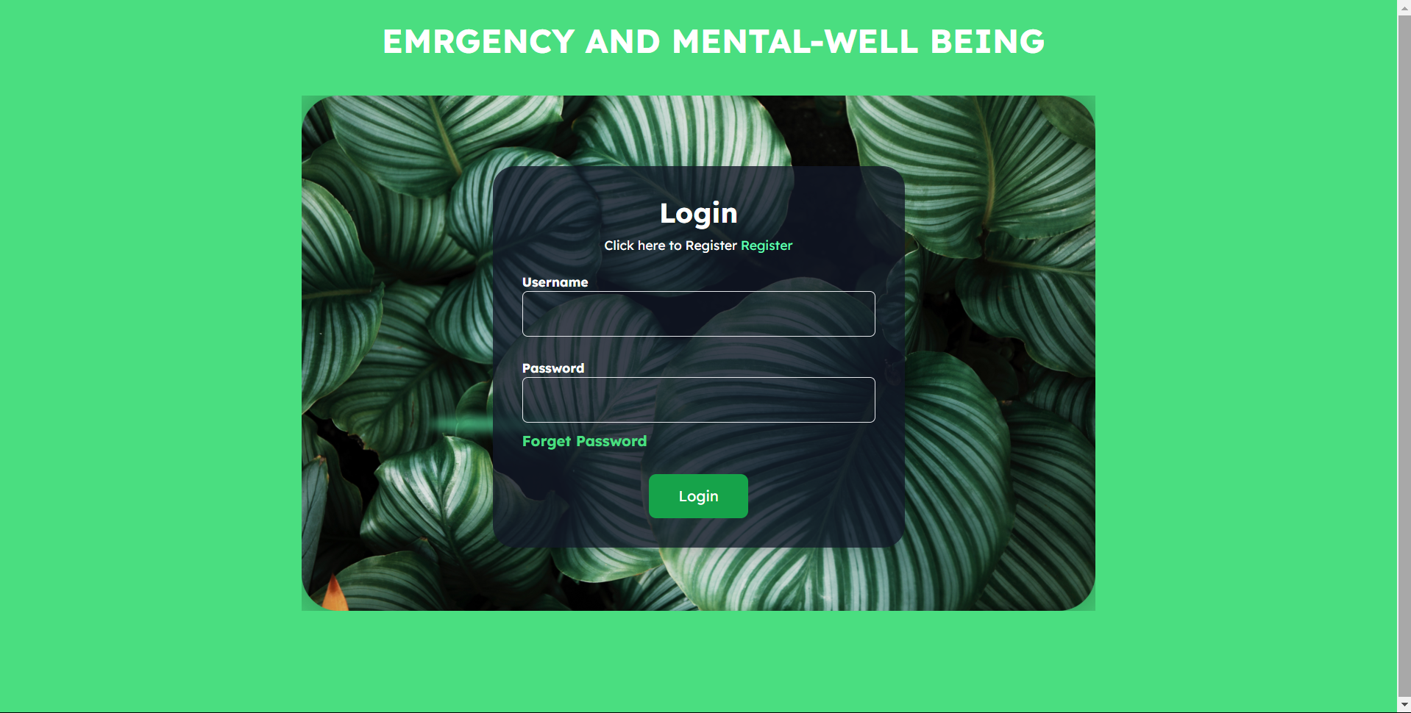
1. Resgistration and Login

Slide 11
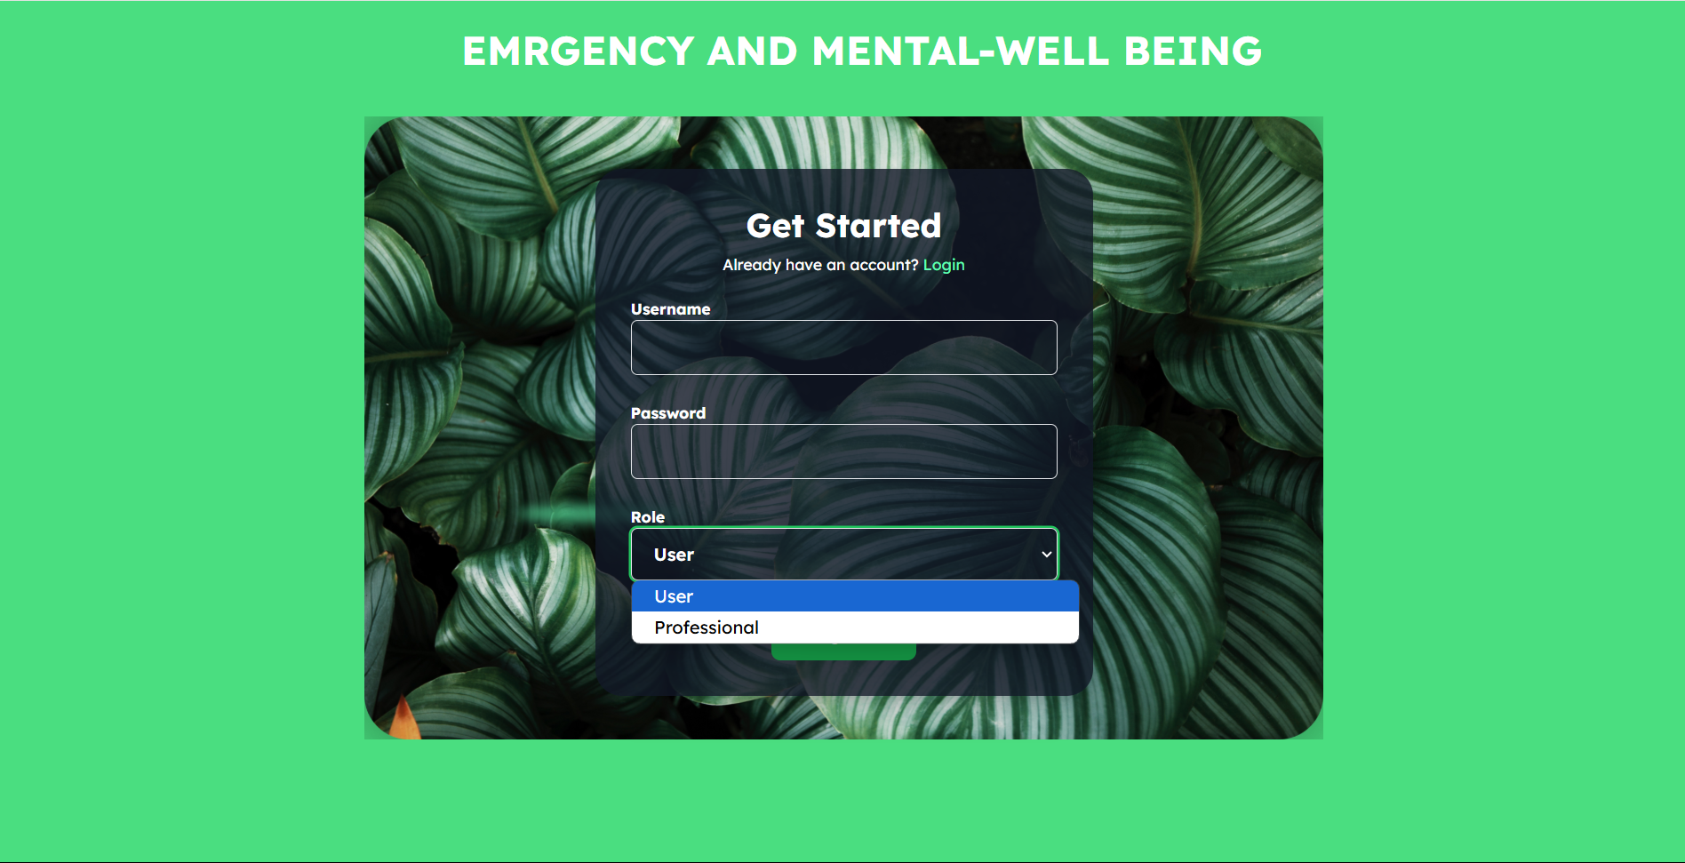

Slide 12
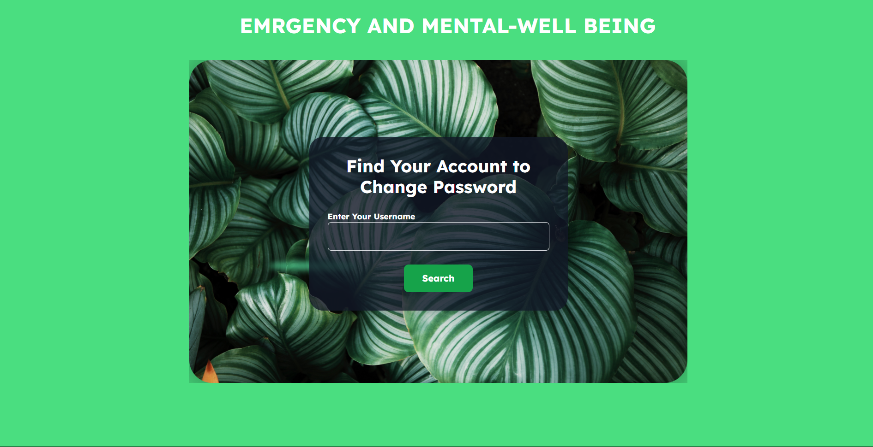
Forget Password

Slide 13
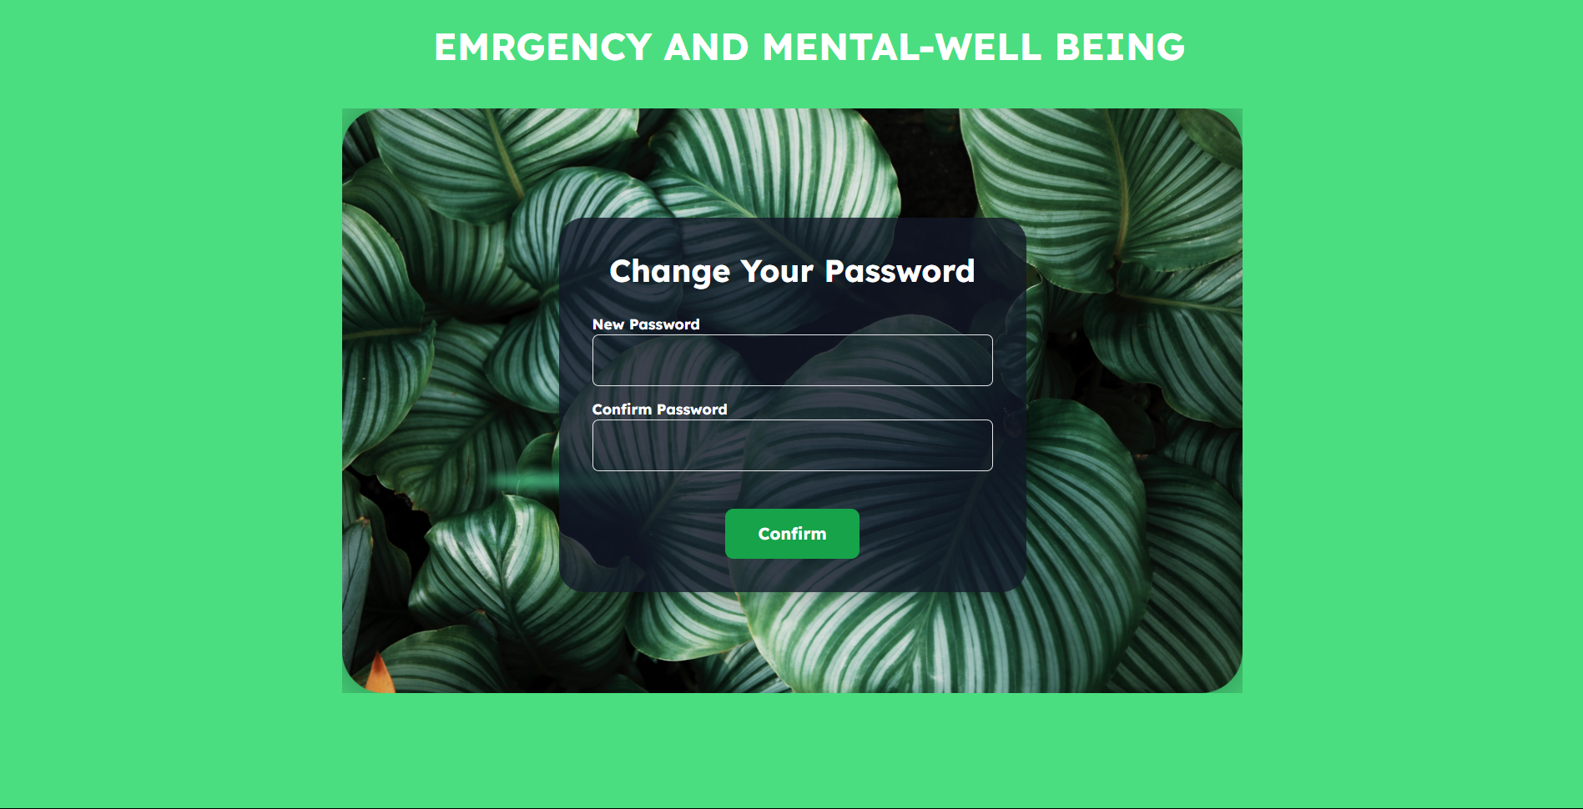
Forget Password

Slide 14
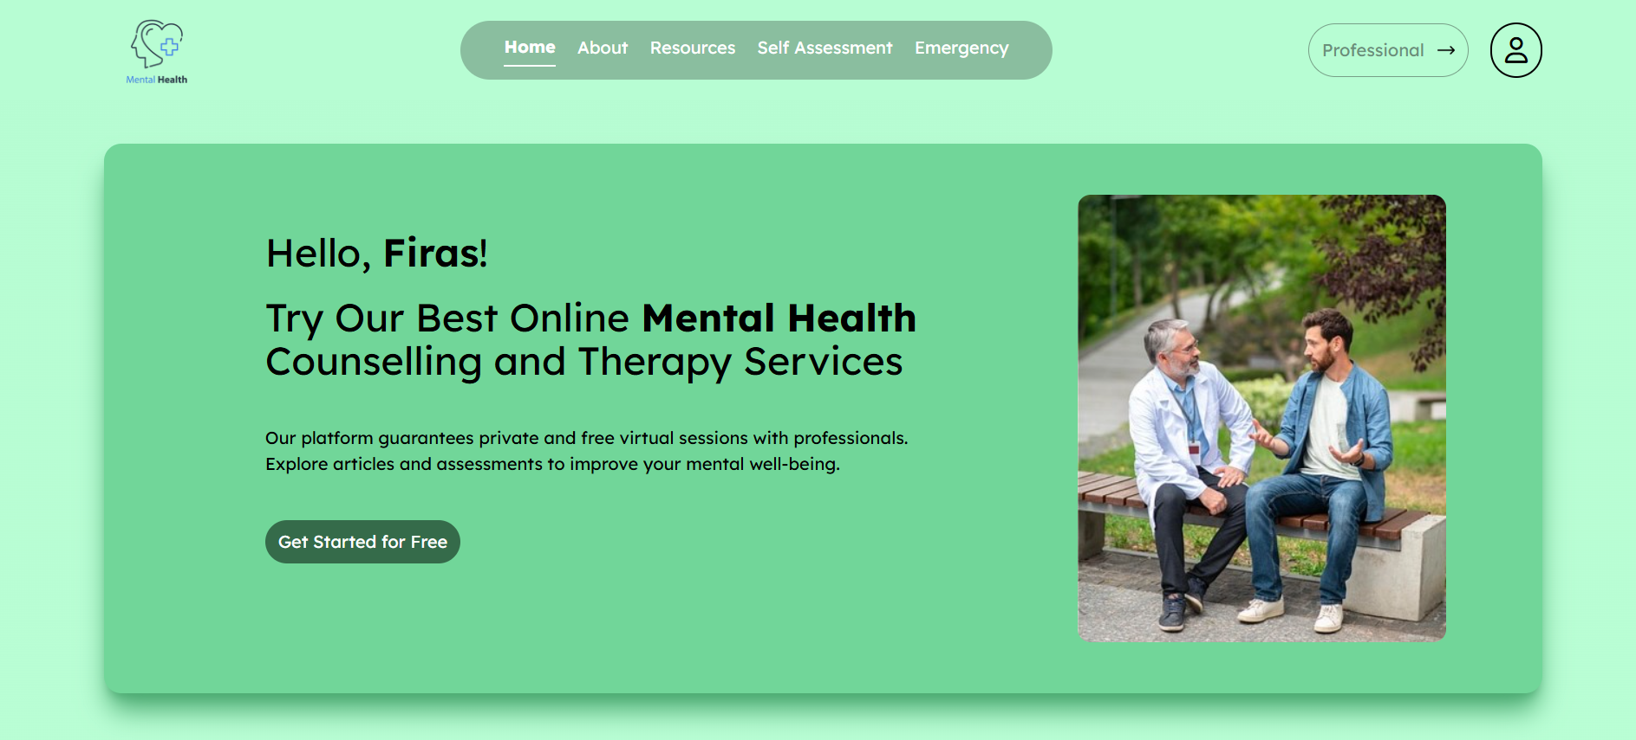
2. User Dashboard
Home Page

Slide 15
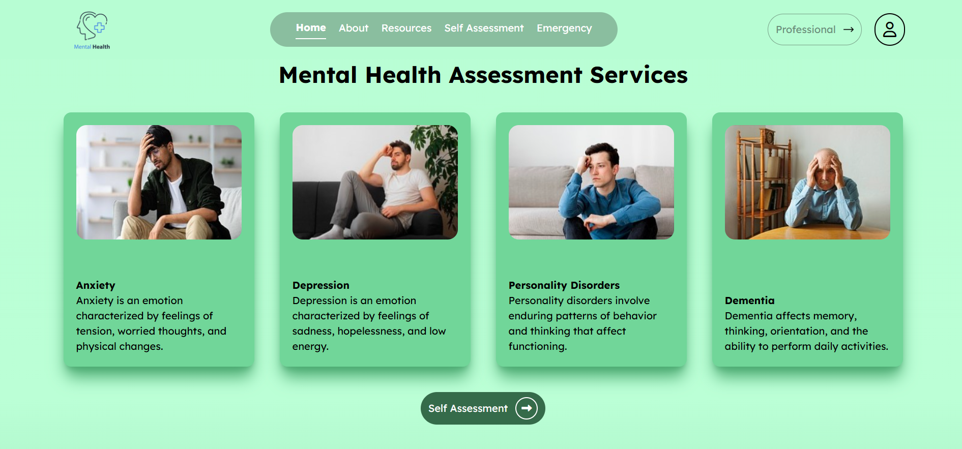
2. User Dashboard
Home Page

Slide 16
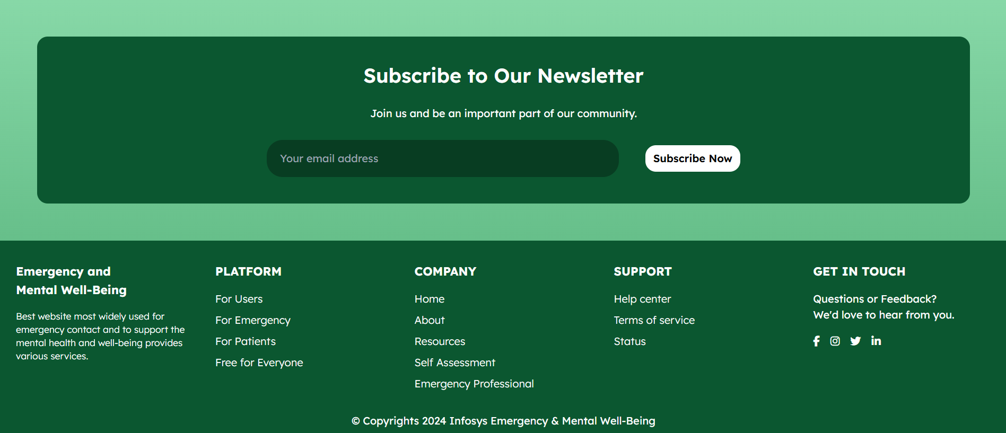
2. User Dashboard
Home Page

Slide 17
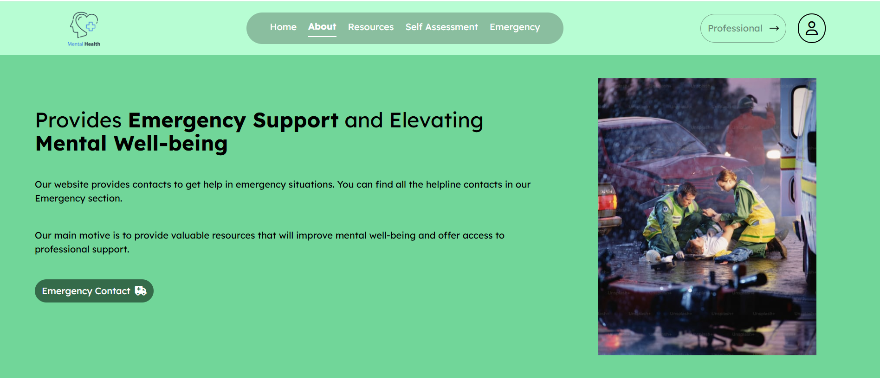
2. User Dashboard
About Page

Slide 18
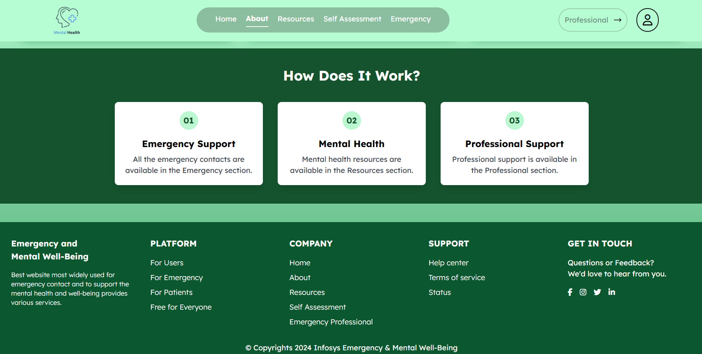
2. User Dashboard
About Page

Slide 19
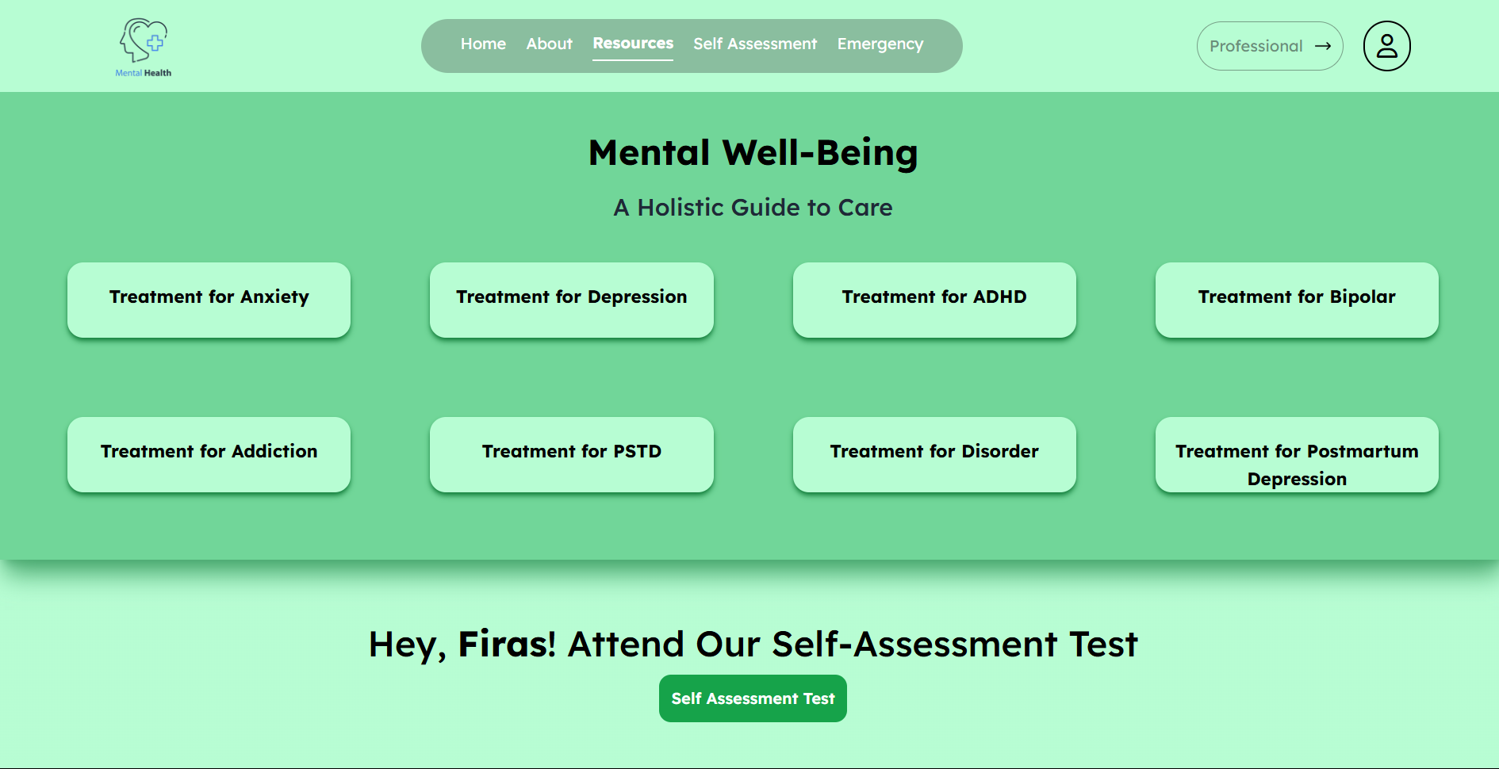
2. User Dashboard
Resource Page

Slide 20
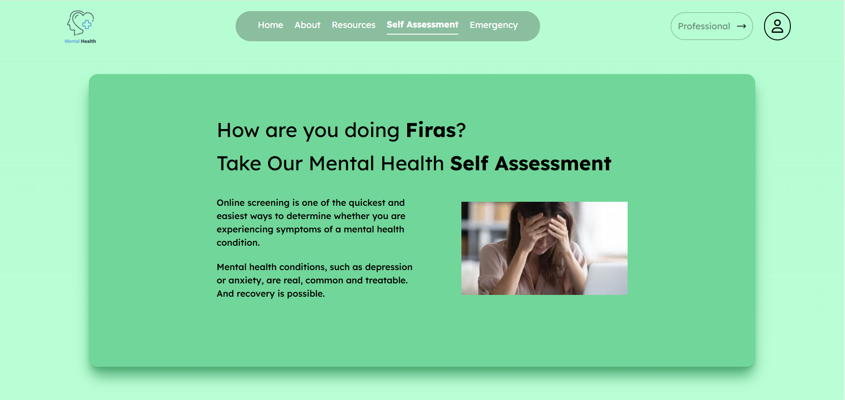
2. User Dashboard
Self Assessment Page

Slide 21
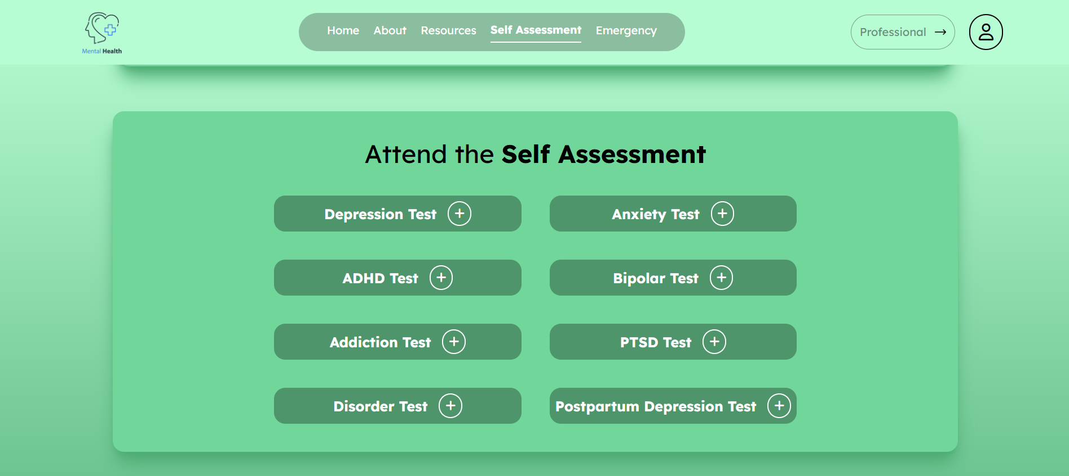
2. User Dashboard
Self Assessment Page

Slide 22
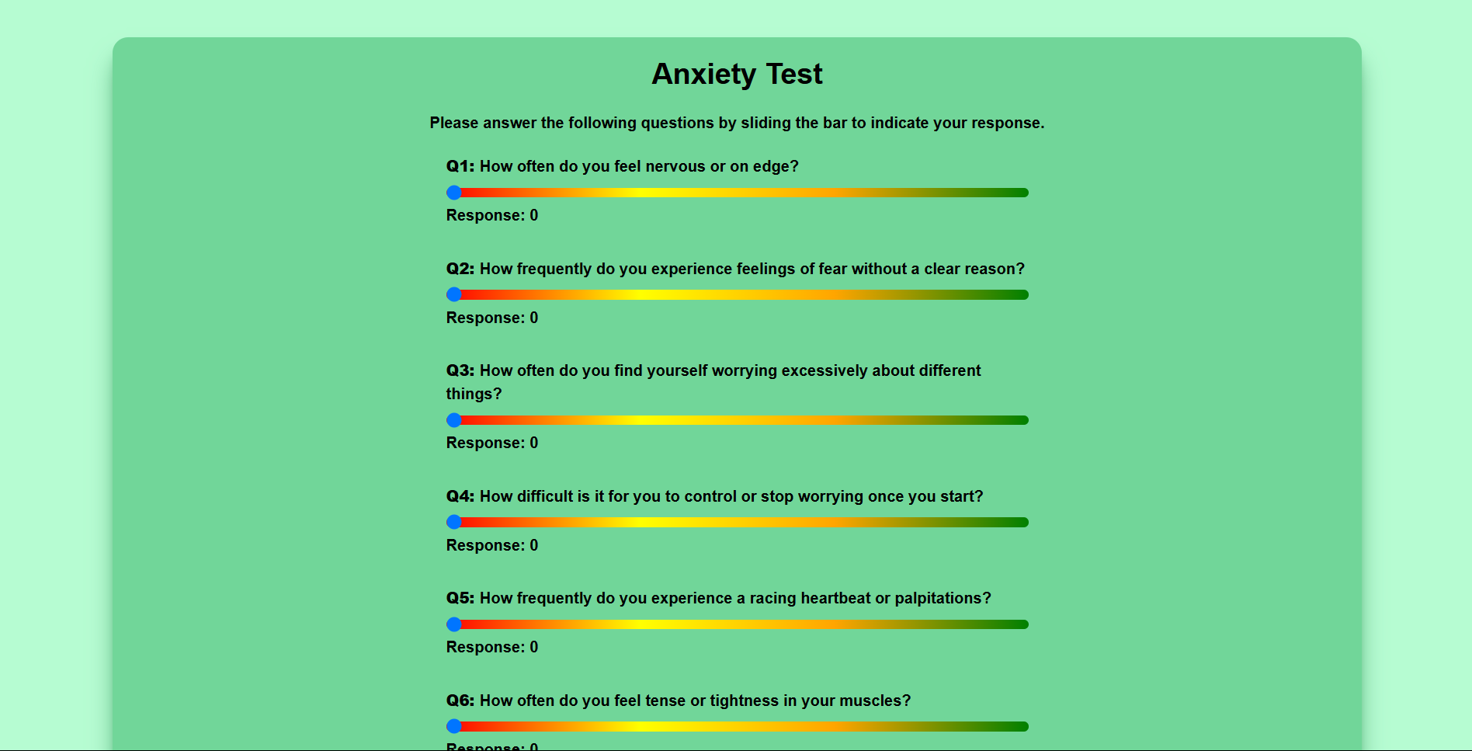
2. User Dashboard
Anxiety Test Page

Slide 23
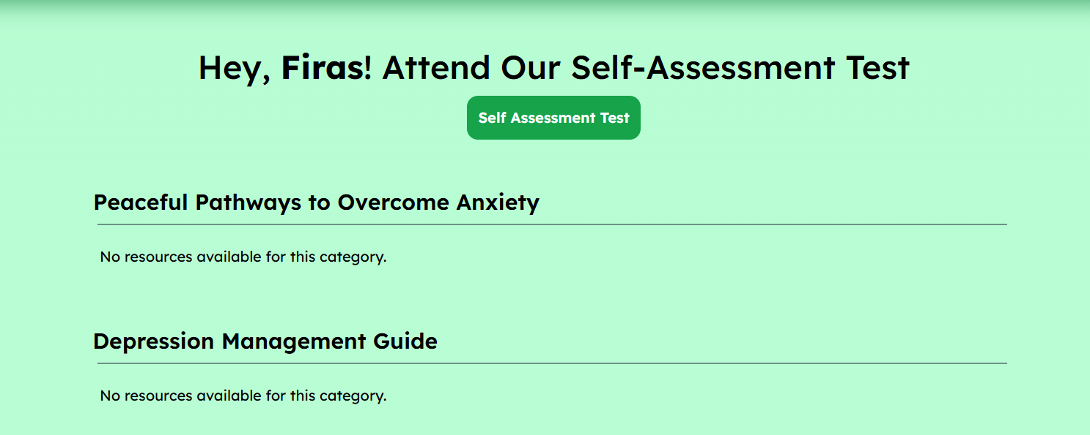
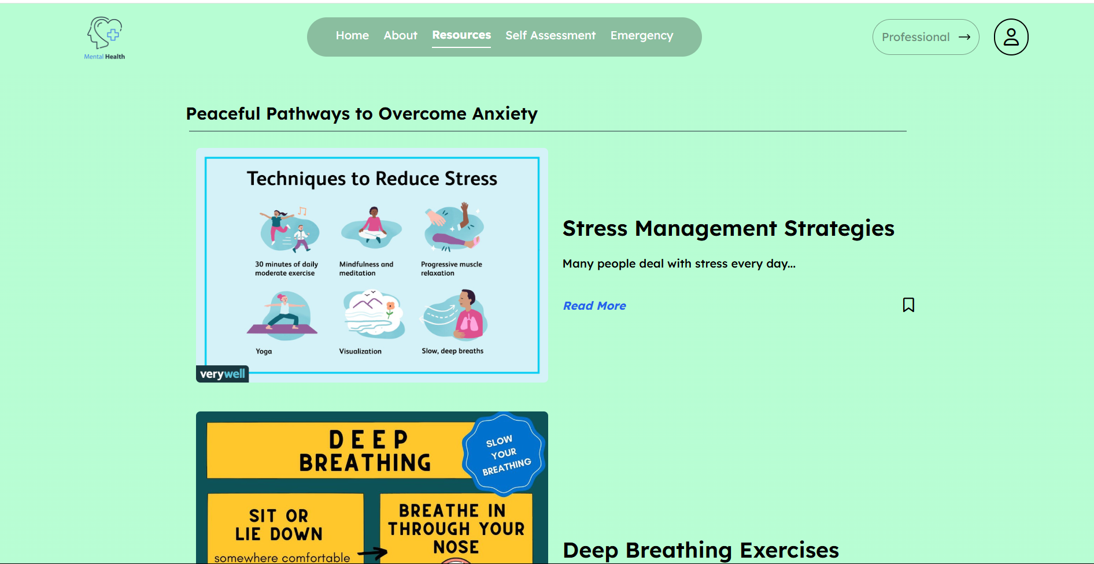
2. User Dashboard
Before Attending
Self Assessment
After Attending
Self Assessment
Recommendation of Resources

Slide 24
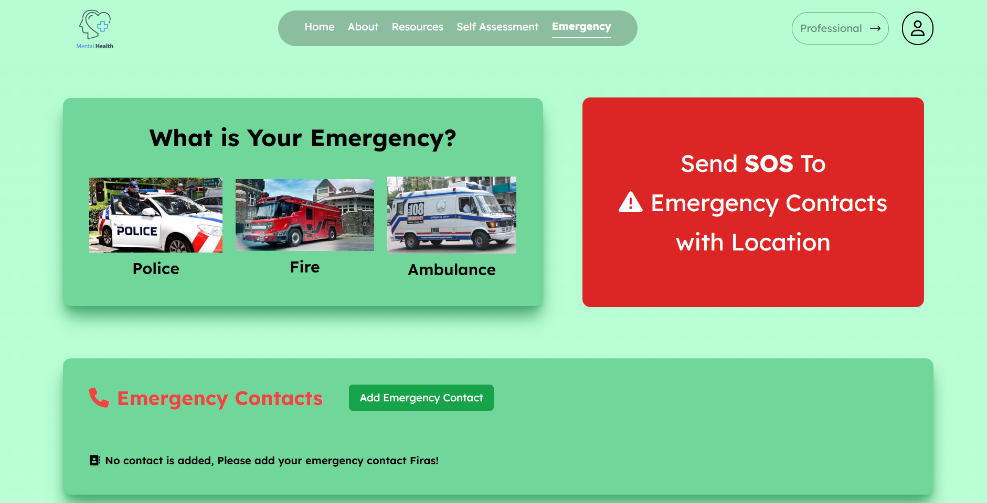
2. User Dashboard
Emergency Contact Page

Slide 25
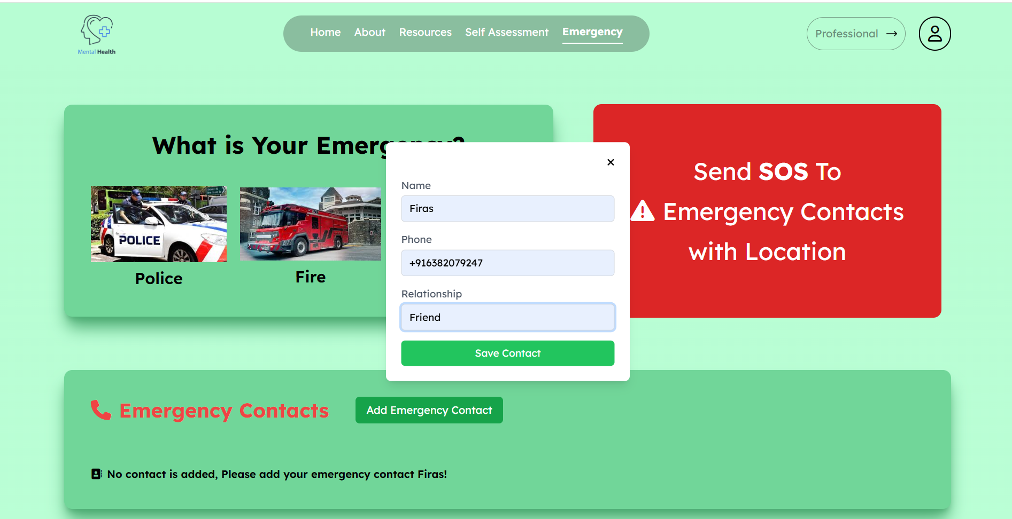
2. User Dashboard
Add Emergency Contact

Slide 26
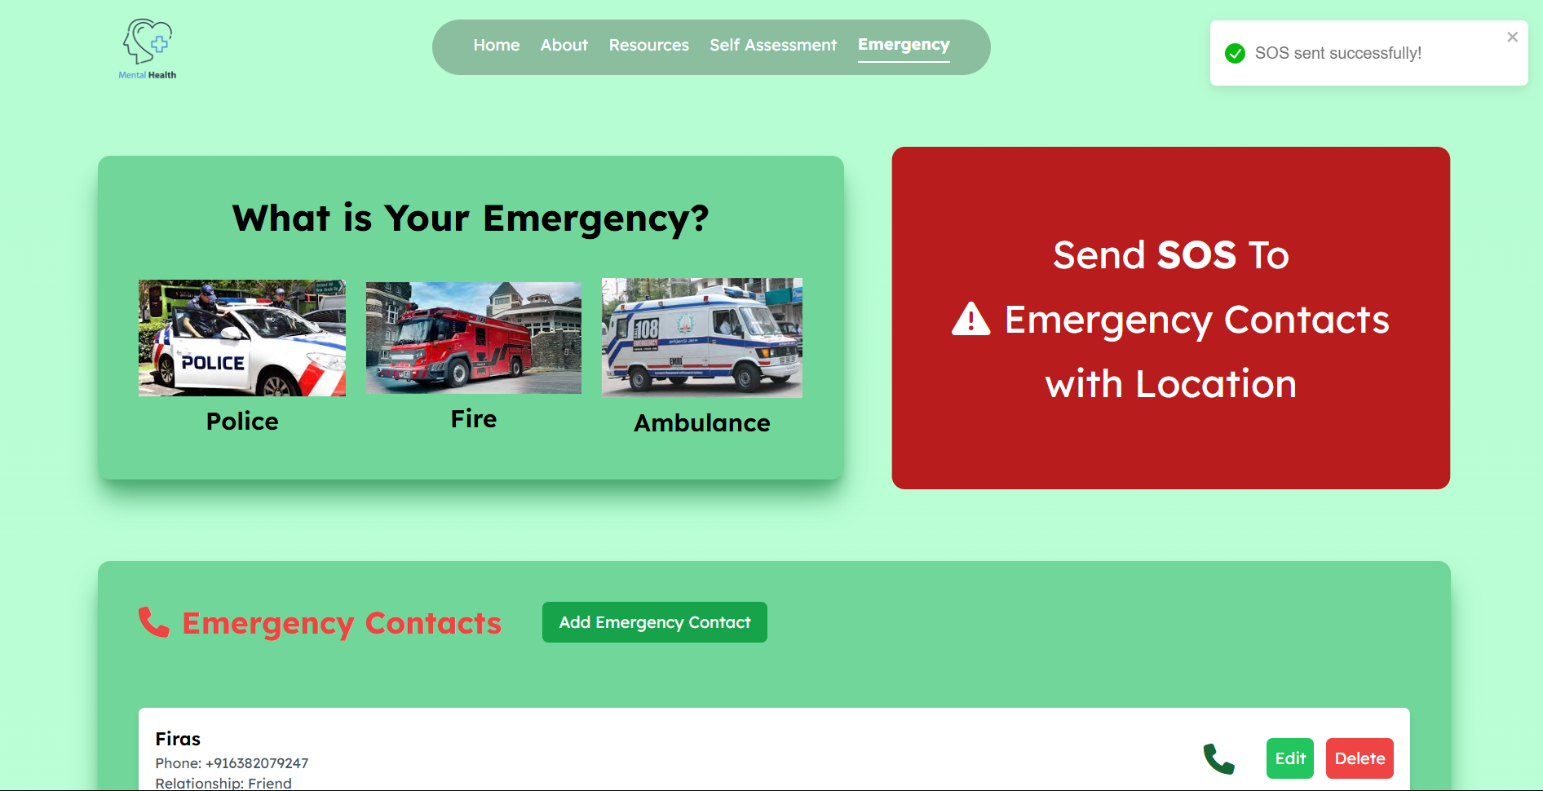
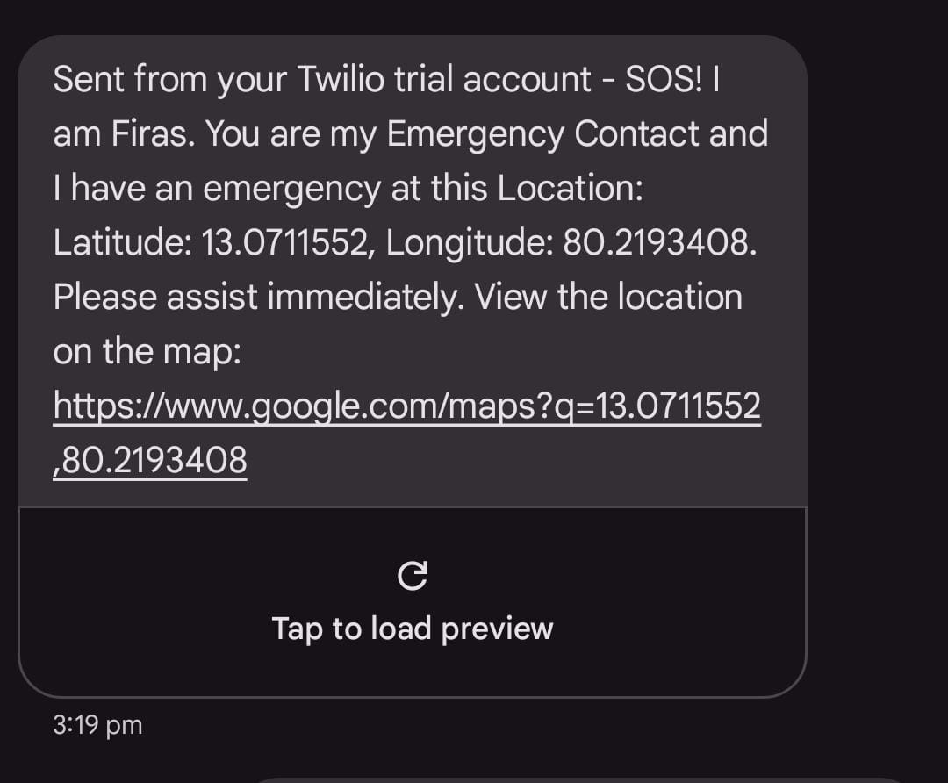
2. User Dashboard
SOS Alert
SOS Message to emergency contact

Slide 27
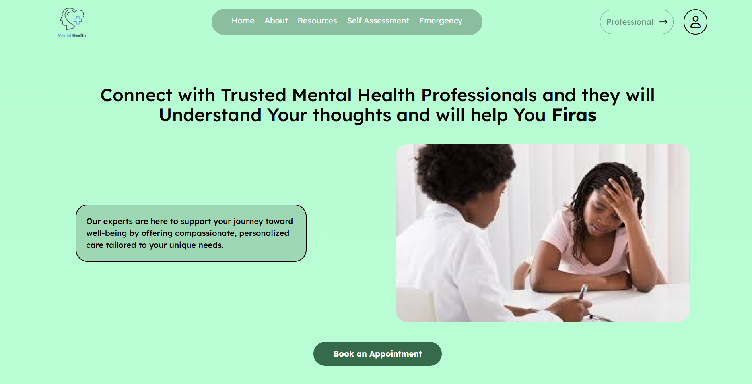
2. User Dashboard
Professional Contact Page

Slide 28
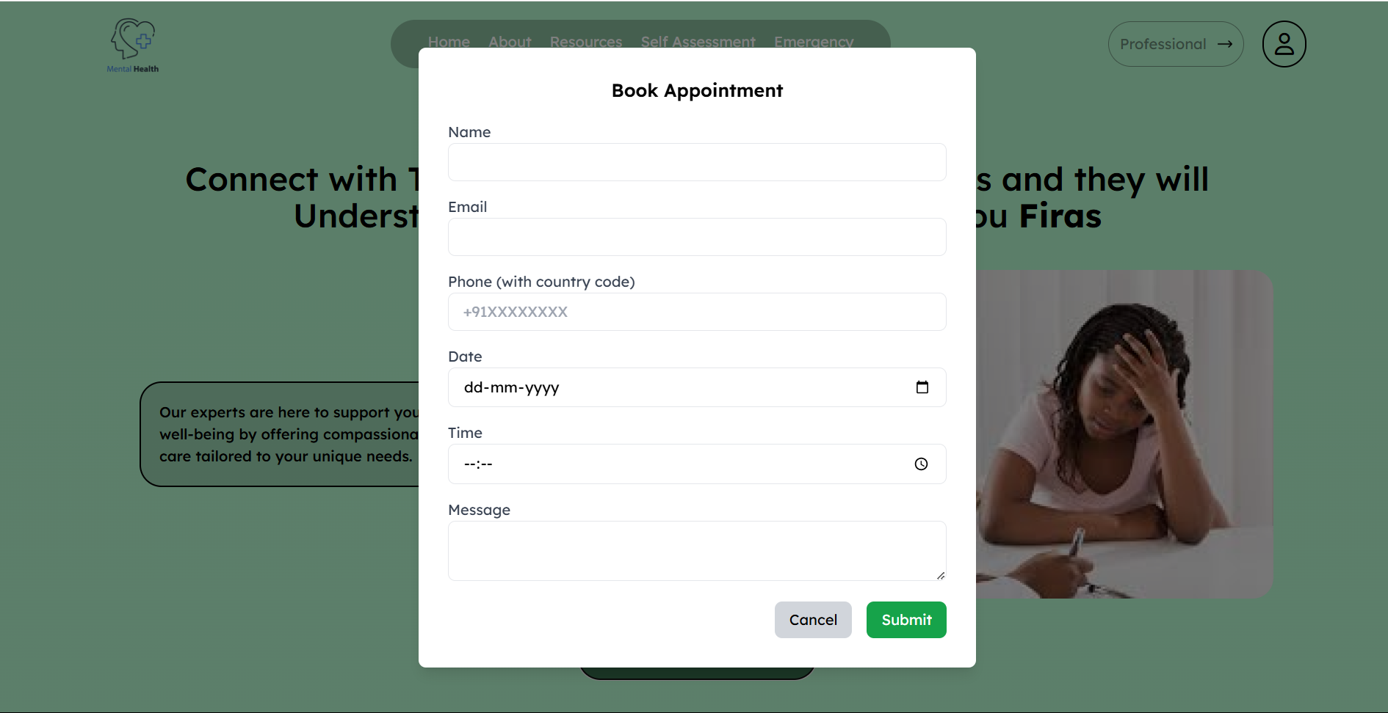
2. User Dashboard
Appointment Form

Slide 29
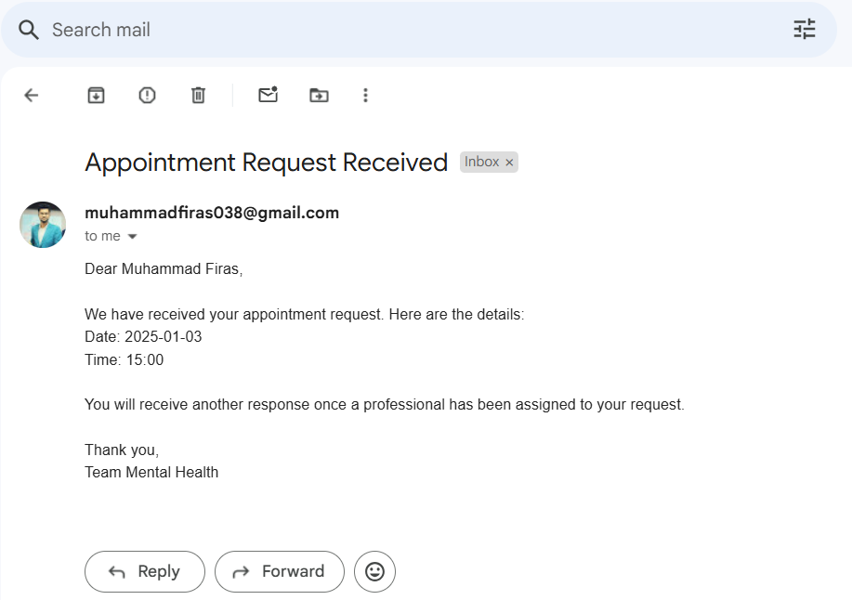
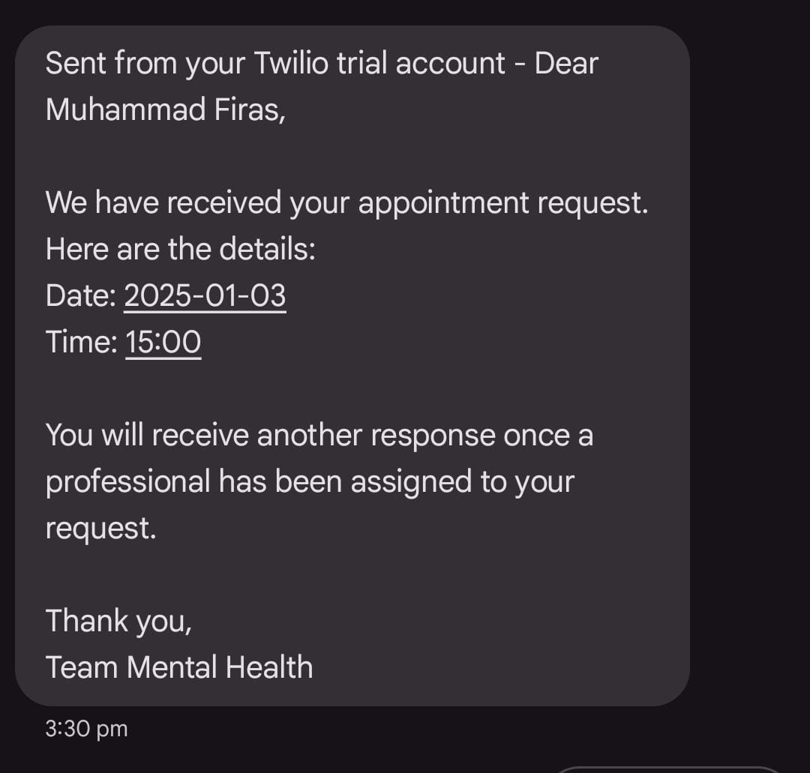
2. User Dashboard
SMS for Successfully submitted
Appointment Form
Email notification for Successfully
Appointment Form

Slide 30
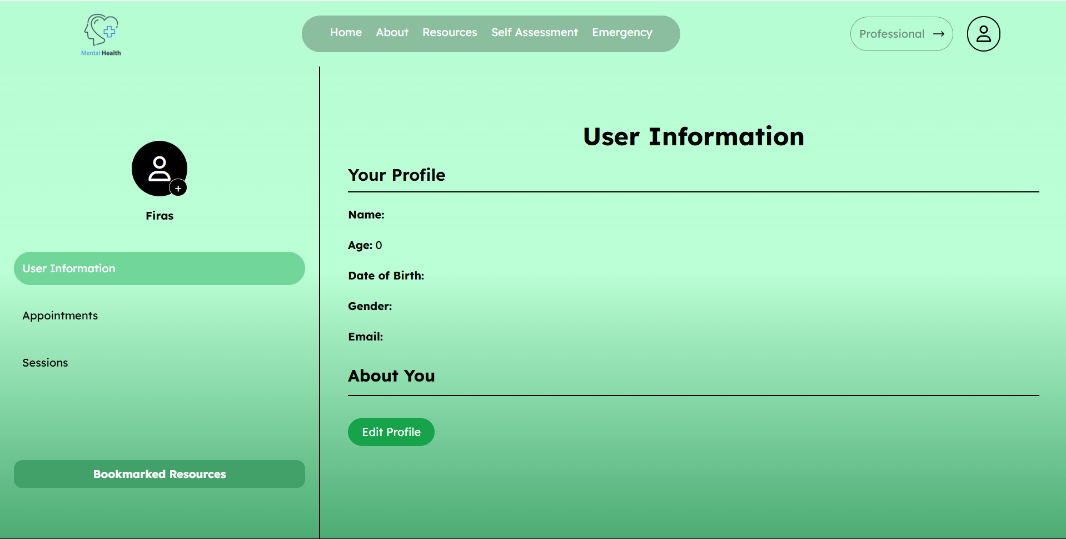
2. User Dashboard
New User Profile page

Slide 31
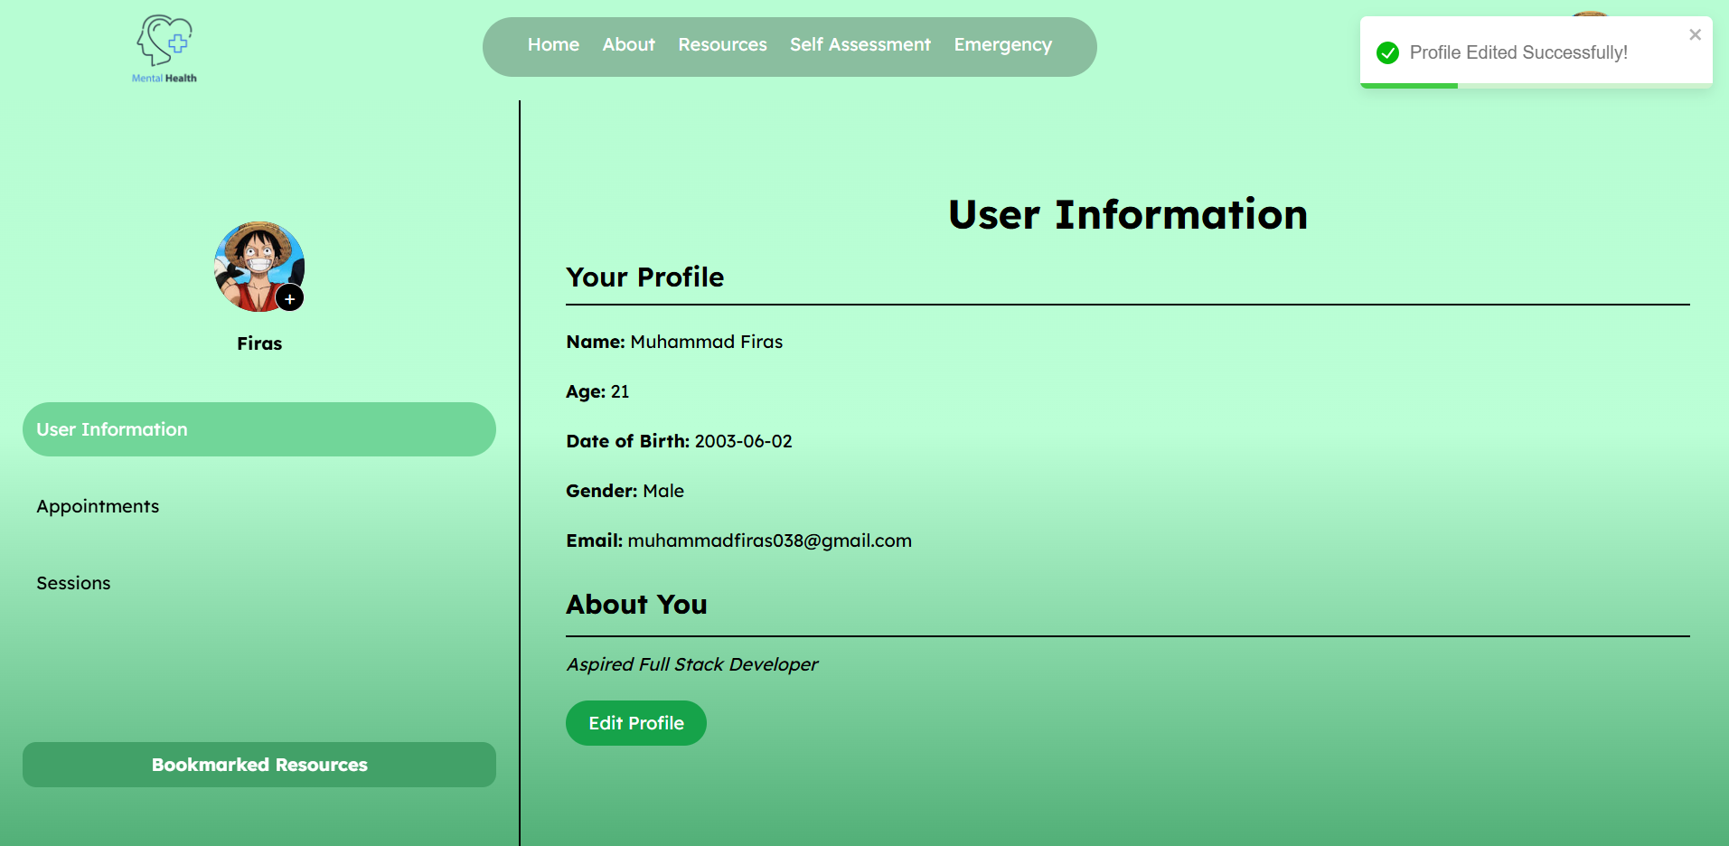
2. User Dashboard
After update Profile page

Slide 32
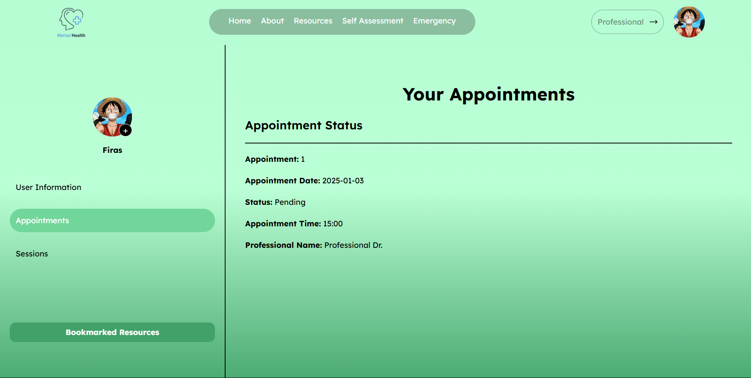
2. User Dashboard
Appointment Status

Slide 33
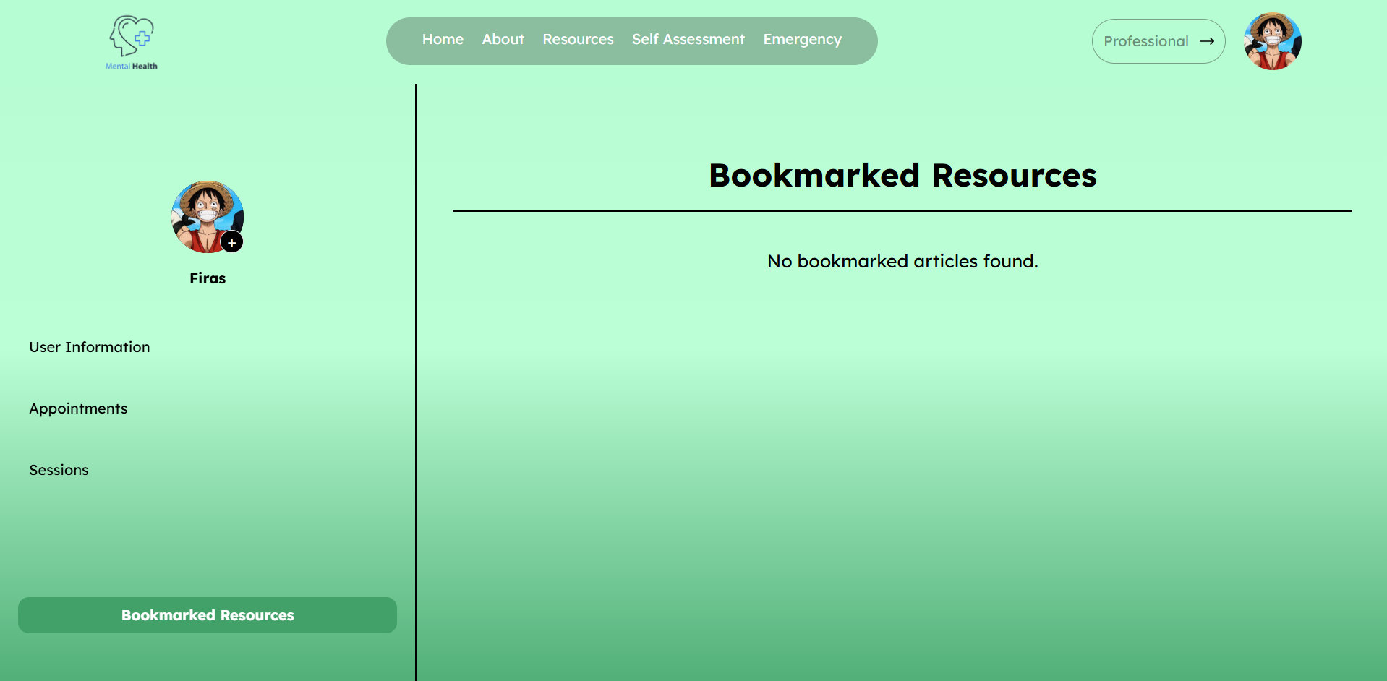
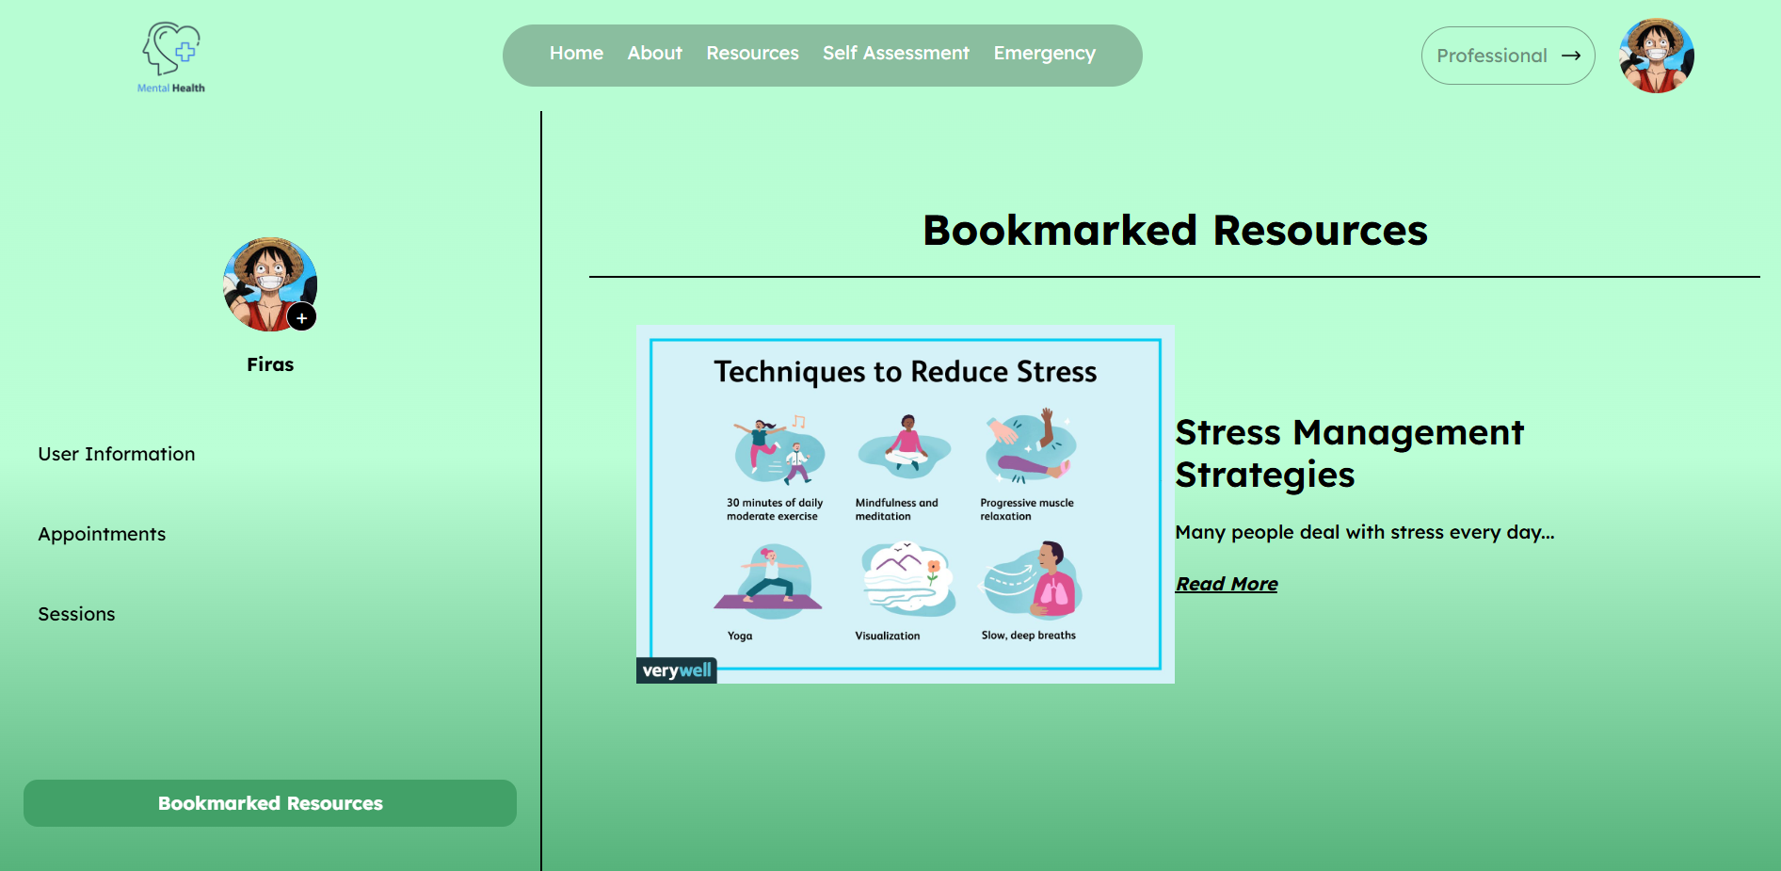
2. User Dashboard
Before Bookmark Resources
After Bookmark Resources

Slide 34
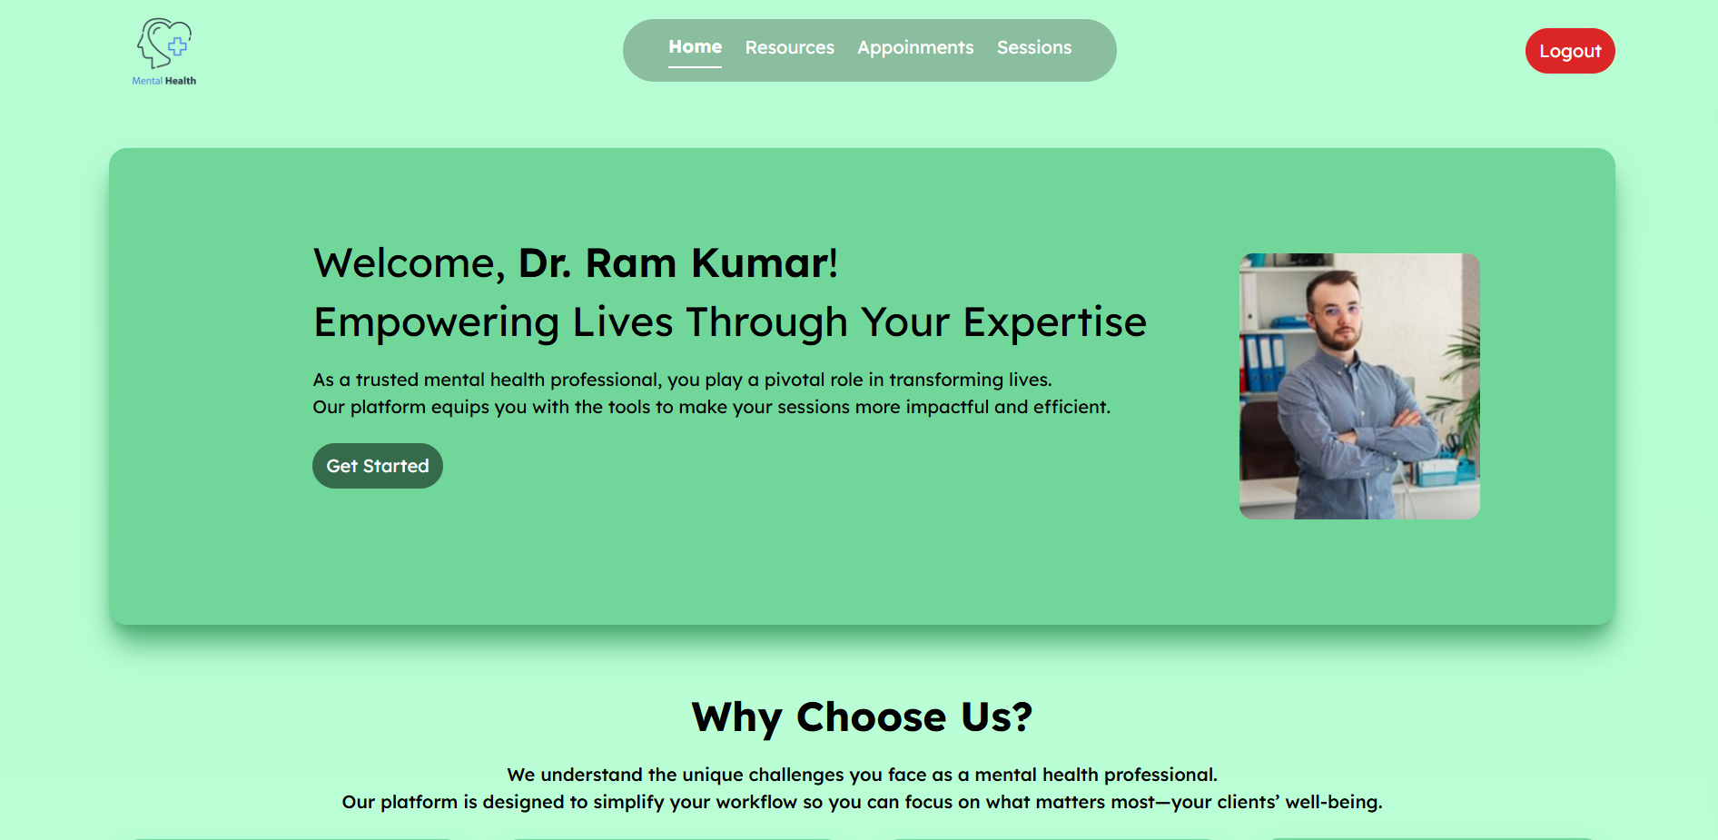
3. Professional Dashboard
Home Page

Slide 35
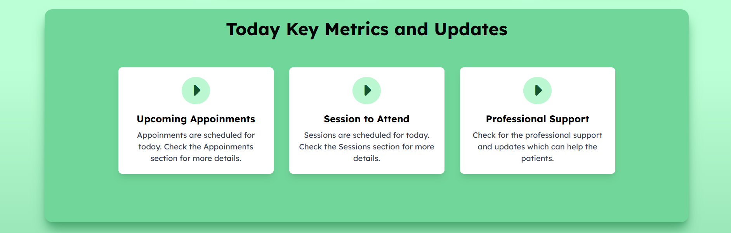
3. Professional Dashboard
Home Page

Slide 36
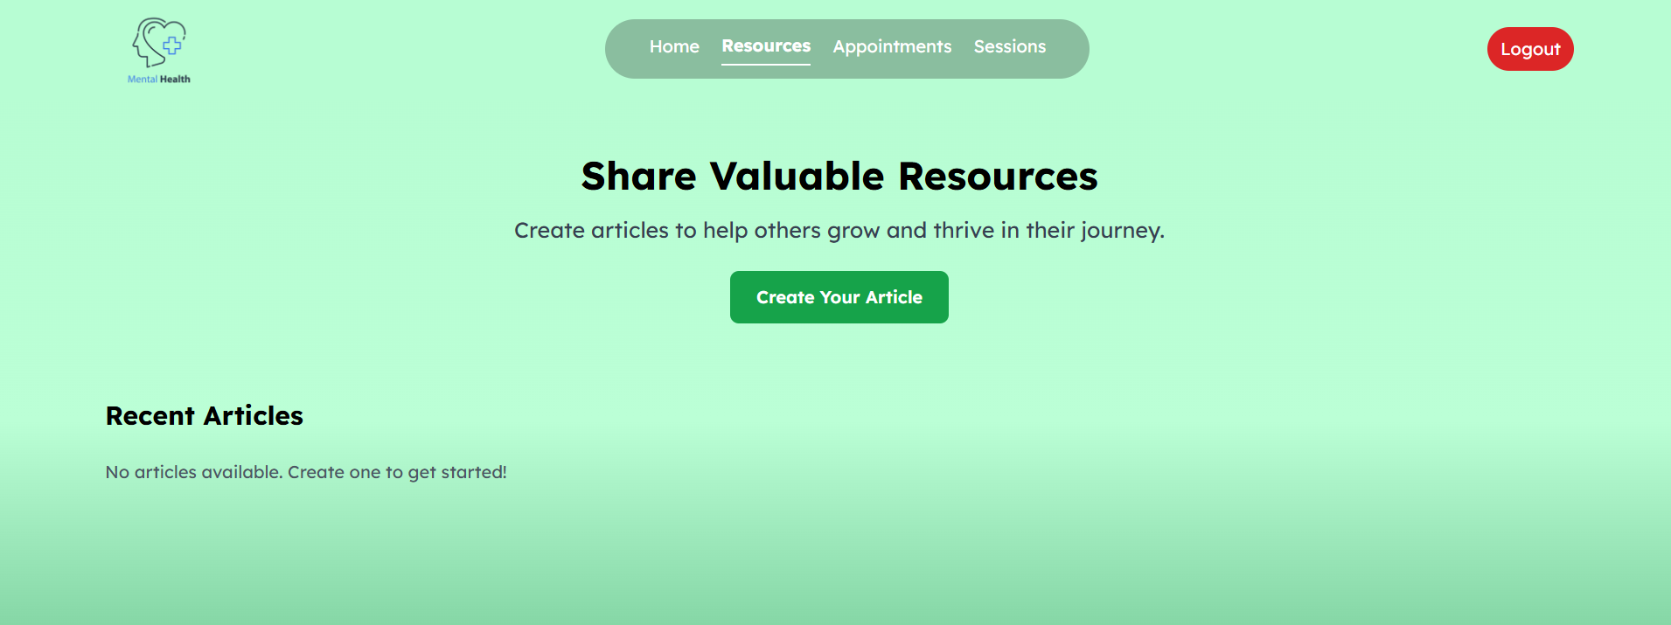
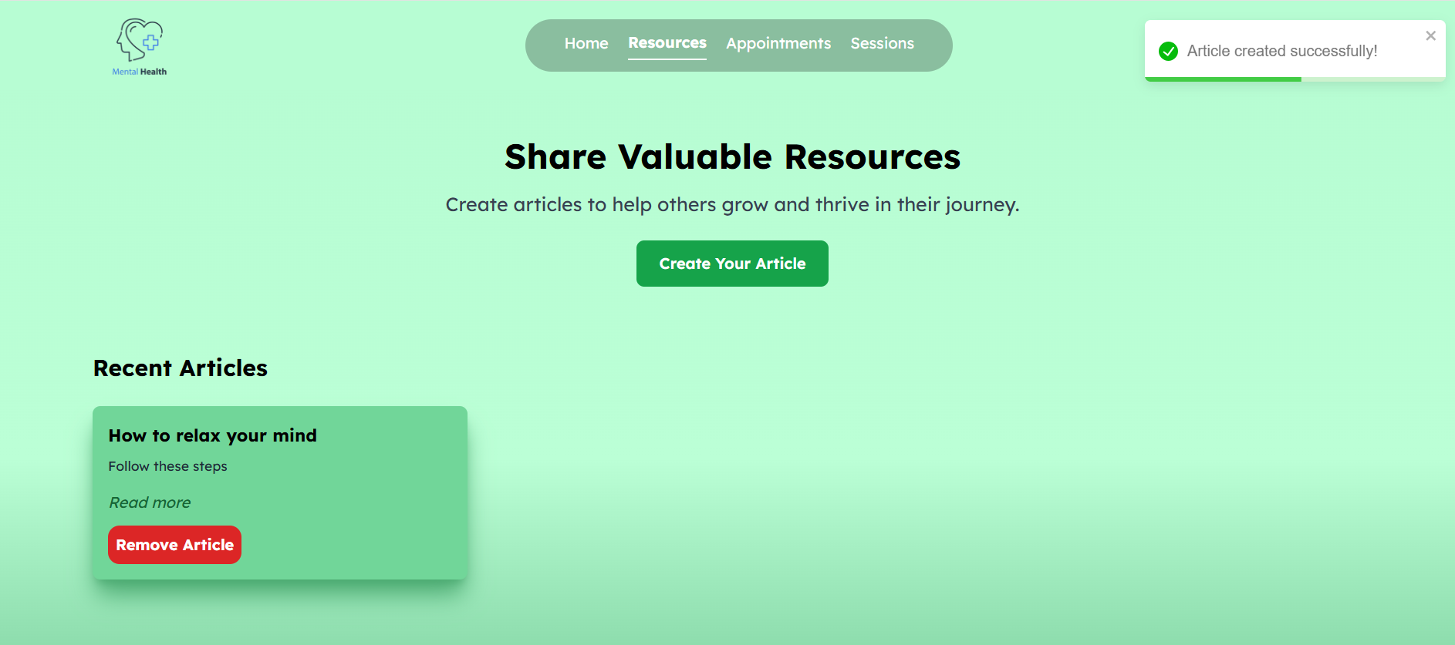
3. Professional Dashboard
Before Creating Resources
After Creating Resources

Slide 37
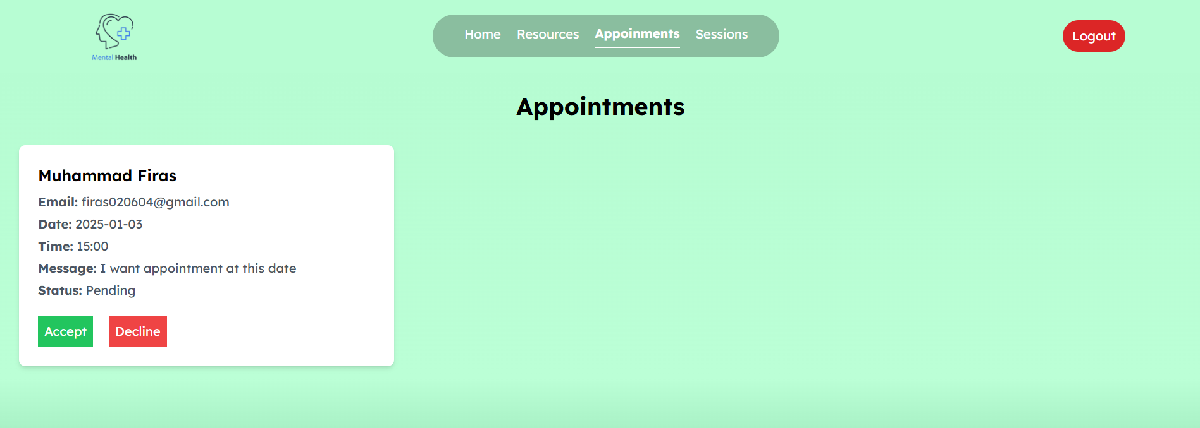
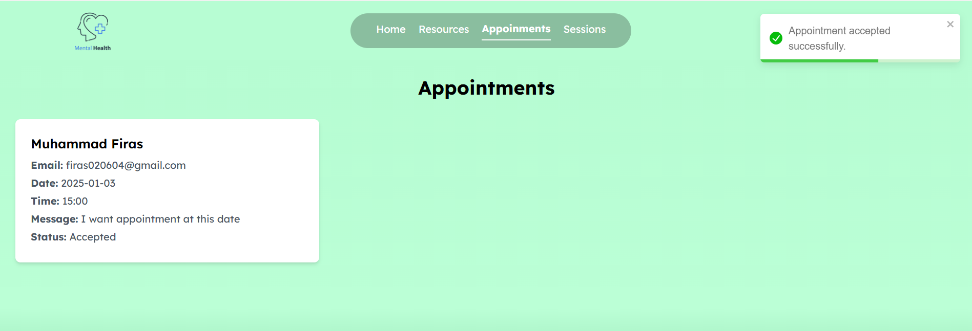
3. Professional Dashboard
Before Accepting Appointment
After Accepting Appointment

Slide 38
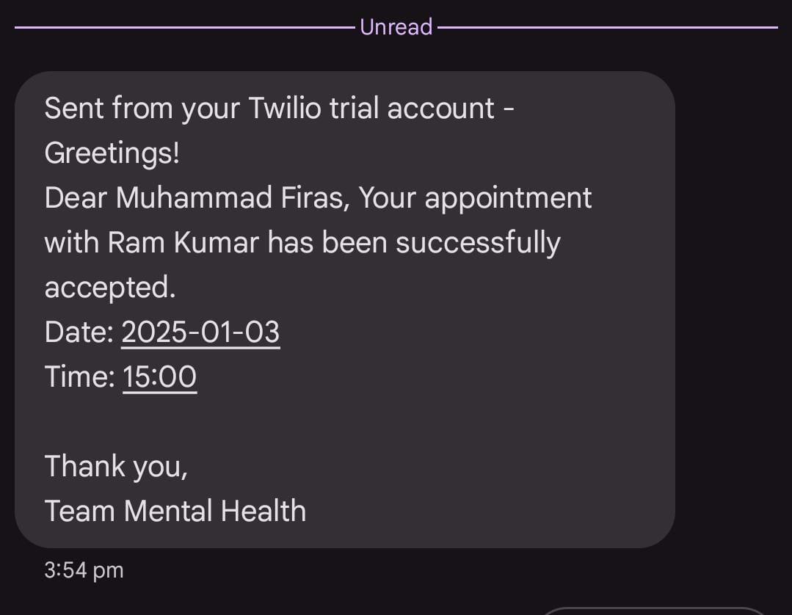
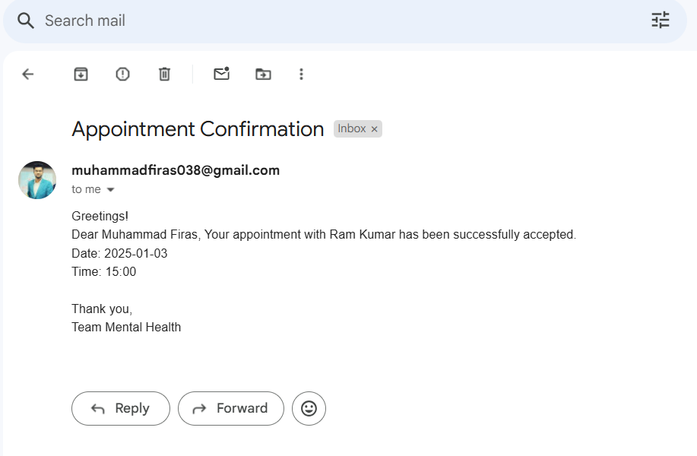
3. Professional Dashboard
SMS after user Appointment got
Accepted by professional
Email after user Appointment got
Accepted by professional

Slide 39
04
Tech Stack
Technology used to develop website

Slide 40

Tech Stack
Frontend:
React JS
Tailwind CSS
Backend:
Java Springboot
Maeven
Database:
Mongo DB

Slide 41
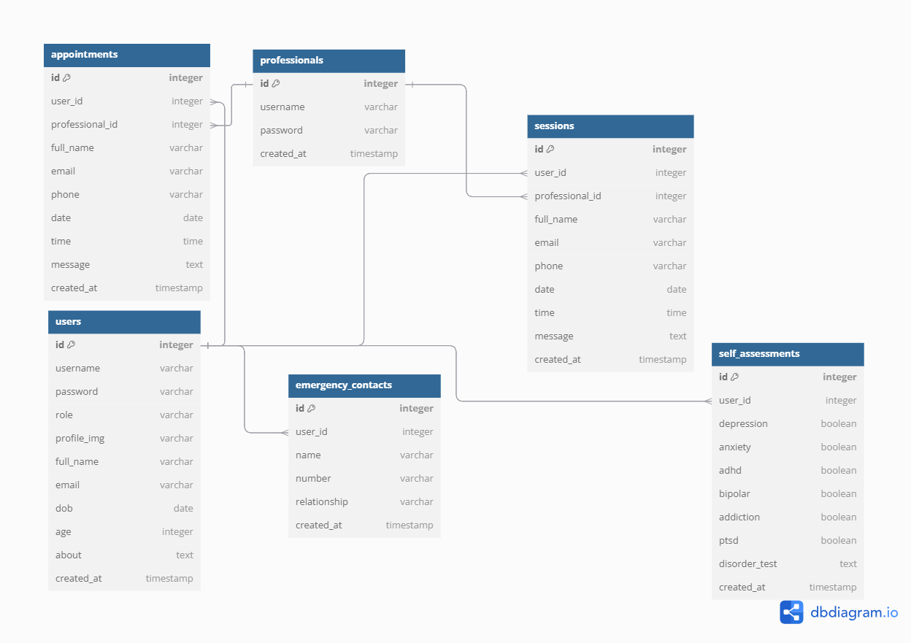
DB Diagram

Slide 42
Thank You!

